Slide 1

Move and Improve Oracle E-Business Suite to Oracle Cloud
<Customer Name> <Meeting Date>

Slide 2




Oracle Provides Options in the Cloud
Re-Implement
with Oracle SaaS Applications
Move and Improve
with Oracle Cloud Platform
ON PREMISES
ORACLE PUBLIC CLOUD
Often, the journey begins with move & improve!

Slide 3


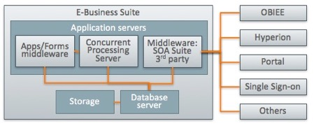
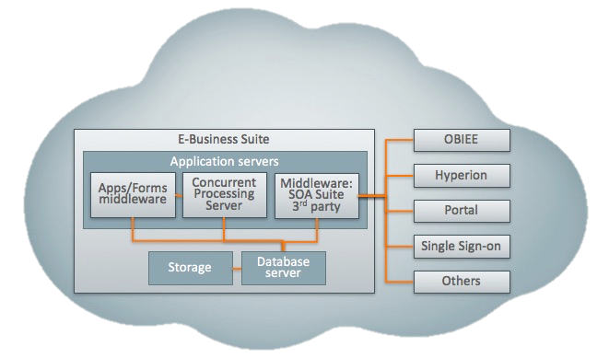
<Customer> can move its EBS (and ecosystem)
to Oracle Cloud Infrastructure
AMC Data Center
Oracle Cloud Infrastructure

Slide 4




Current Environment and Challenges <Customer Name>
EBS Application Portfolio / Users by Module
Technology Portfolio
Platform_os_1
Platform_os_2
EBS Environments / Versions
ebs_version
Database Portfolio
Challenges_1
Db_version
Challenges_2
Challenges_3

Slide 5
Running EBS on Oracle Cloud Reduces Both Hard & Soft Costs
Up To $1.4 Million Lower Costs Over 5 Years!
Sample EBS Environment: 150 Concurrent Users, 1 TB Database, No RAC
HARDWARE & DATACENTER
-$900 K
-$1.4 M
CLOUD
PEOPLE
Time to Market Improvements
Reduced Business Disruption
Improved Developer Productivity
SUPPORT & SERVICES
On-Premises
Cloud
Cloud + Business Benefits
Notes:
Assumptions:
DB Support: $14k
App Support: $60k
Annual Rev: $250 M
Revenue Growth: 5%
% of Growth Tied to Cloud Initiatives: 10%
# Additional Days to Deploy On-prem: 24
On-prem Availability: 99.7%
Admin Salary: $90k
Developer Salary: $120k
Discounts:

Slide 6
Running EBS on Oracle Cloud Reduces Both Hard & Soft Costs
Up To $1.9 Million Lower Costs Over 5 Years!
Sample EBS Environment: 500 Concurrent Users, 3 TB Database, No RAC
HARDWARE & DATACENTER
-$1.3 M
-$1.9 M
CLOUD
PEOPLE
Time to Market Improvements
Reduced Business Disruption
Improved Developer Productivity
SUPPORT & SERVICES
On-Premises
Cloud
Cloud + Business Benefits
Notes:
Assumptions:
DB Support: $55k
App Support: $140k
Annual Rev: $750 M
Revenue Growth: 5%
% of Growth Tied to Cloud Initiatives: 5%
# Additional Days to Deploy On-prem: 15
On-prem Availability: 99.7%
Admin Salary: $90k
Developer Salary: $120k
Discounts:

Slide 7
Running EBS on Oracle Cloud Reduces Both Hard & Soft Costs
Over $7.3 Million Lower TCO Over 5 Years!
Sample EBS Environment: 2000 Concurrent Users, 7 TB Database, Up to 4 Node RAC
HARDWARE & DATACENTER
-$4.4 M
-$7.3 M
CLOUD
PEOPLE
Time to Market Improvements
Improved Developer Productivity
SUPPORT & SERVICES
On-Premises
Cloud
Cloud + Business Benefits
Notes:
Assumptions:
DB Support: $300k
App Support: $600k
Annual Rev: $5 B
Revenue Growth: 3%
% of Growth Tied to Cloud Initiatives: 10%
# Additional Days to Deploy On-prem: 15
On-prem Availability: 99.9%
Admin Salary: $100k
Developer Salary: $120k
Discounts: IaaS: 10%, ExaCS: 30%

Slide 8


Running EBS in the Cloud Benefits Your Business
Without Causing Disruption or Change
Improved time-to-market
Shortened project times
On-demand self-service
Automated quick provisioning of fresh images
Increased availability
Support from single vendor
High performance cloud infrastructure
In the cloud, faster means cheaper
Reduction in labor to run & maintain
Automated migration of on-prem environment
Hybrid cloud app management & monitoring
Rapid elasticity: Automated scaling & load balancing
Upgrade & patching automation
NO BUSINESS DISRUPTION
The E-Business suite you KNOW
The E-Business suite you OWN
The E-Business suite you CUSTOMIZED
Benefits - Whitepaper: E-Business Suite on Oracle Cloud
Copyright © 2017, Oracle and/or its affiliates. All rights reserved. |

Slide 9




Oracle Gives You the Choice to Deploy E-Business Suite Where and How You Want
Deploy EBS where you want
Deploy EBS how you want
You can deploy E-Business Suite in any of these models
Dev
Test
Training
DR
Prod
Reporting
On-premises
Cloud at
Customer
Oracle Cloud
Infrastructure
Full support & automation for hybrid deployments
Many organizations start with Dev/Test/Training
Then add or migrate DR to cloud
Shift Prod to cloud when ready
Place “reporting” instance on cloud
With these options you can fine-tune how efficiency, agility, and innovation meet choice and control

Slide 10

Oracle Provides Complete Automation to Move Your EBS from On-premises to Oracle Cloud Infrastructure
EBS Dev
EBS Test
EBS Prod
EBS Dev
EBS Test
EBS Prod
Encrypted network
On-prem EBS instances
Cloud EBS instances
Your data center
Oracle Cloud Infrastructure

Slide 11

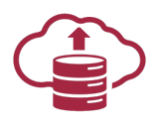
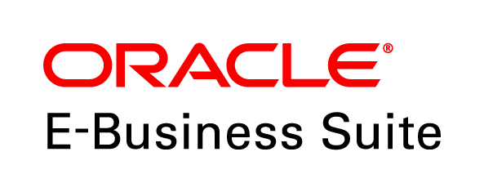

This level of automation is not available on AWS or Azure
QUICK PROVISIONING
Common Use Cases:
Fresh Installation
Demo Environments
Development Tools
Flexible Topology
LIFT AND SHIFT FULLY CONFIGURED EBS SYSTEMS
Lift and shift your on-premises environments to Oracle Cloud Infrastructure, including:
EBS configuration
Historical data
Customizations
LIFECYCLE MANAGEMENT
Fast cloning, backup and restore
Environment elasticity (managed server, JVM memory, delete/add nodes)
Disaster recovery (DR) configuration
End-to-end monitoring, patch and customization management using Application Management Suite

Slide 12





Pre-Tested Reference Architectures Available Re-platform E-Business Suite onto Oracle Cloud IaaS/PaaS
Client Tier
Application Tier
Network
Database Tier
HTTP/HTTPS
Network – WAN / LAN / VPN
Exadata
Load Balancer
Compute
SUN J2SE Plug-in
Compute
Database
EBS Client Applet
APP Tier 1
APP Tier 2..n
J2EE Server
J2EE Server
Web Services
Apache HTTP Listener
WLS Servlet Engine (JSP)
Web Services
Apache HTTP Listener
WLS Servlet Engine (JSP)
EBS Database
Concurrent Processing Engine
EBS Database
Oracle 11gR2/12C RAC
Forms Services
Forms Services
Oracle 11gR2/12C RAC
Storage
Database Backup
Application Tier Storage
Storage
Database and Backup Tier Storage

Slide 13


You can use your existing licenses in the Oracle Cloud
You must be fully licensed to run E-Business Suite, but you can bring your existing licenses and use them on Oracle Cloud. In that case, you pay only for the infrastructure you use (compute, storage, network).
Or you can take advantage of the licenses built into Oracle Cloud Platform services such as Database Cloud Service, Exadata Cloud Service or Java Cloud Service.
E-Business Suite:
Bring your own license to Oracle Cloud (BYOL)
EBS licenses are needed for Prod instance only
Oracle Cloud Infrastructure:
Subscribe to basic IaaS services (compute, storage, network)
BYOL for App Server EE on Compute
BYOL Database EE on Compute or BYOL Database EE to Database Cloud Service or Exadata Cloud Service
Copyright © 2017, Oracle and/or its affiliates. All rights reserved. |

Slide 14

Oracle Ensures Your Success
Oracle Professional Services
Success Services
Migration Services
Run & Maintain Services
Available at no charge to address customer needs through the entire cloud adoption lifecycle
Business value engagement to help develop a self funding business case for cloud adoption
Cloud & hybrid adoption principles
Facilitated Adoption Workshops
Prescriptive advice and coaching
Health and Value Realization Check
Assessment & discovery of application footprint and cloud infrastructure requirements
Design and architect to meet custom needs, including high availability
Transition planning and execution to move environments and setup customizations
Cloud management expertise to deploy applications securely
Support for stabilization and go-live
SLA driven lifecycle management (refresh, backup, provisioning) for production
Reduced vulnerability and enhanced security with managed security services
Multiple cloud deployment models with production either on-premises or at Oracle
Choice of extended services such as functional help desk, integration, customization management
Key transaction monitoring for faster issue resolution

Slide 15


Sustainable ingredient company moved EBS and other Oracle applications to the cloud
Challenges
Reduce data center and hardware costs
Unable to replace E-Business Suite, Hyperion with SaaS
Requires high performance, low latency
Solution
Migrate EBS, BI and data integration apps to Oracle Cloud Infrastructure
Leverage Oracle Database with Data Guard & RAC
Achieve high performance with Bare Metal with NVMe
Secure VCN and FastConnect dedicated connectivity
Results
Doubled performance on workloads like reporting
Achieved predictable, fast connectivity
Consolidated 19 database systems down to three
Shut down data center
Download Darling Ingredients Inc. whitepaper
Copyright © 2017, Oracle and/or its affiliates. All rights reserved.

Slide 16


Challenges
Shift IT focus from maintenance to innovation to better serve customers and optimize profitability
Move entire data center to cloud in 120 days
Solution
Moved on-premises E-Business Suite to Compute Cloud, Database Cloud, and Java Cloud
Entire IT footprint is also moving to Oracle Cloud
Results
Slashed application costs, time-to-revenue and outages
Can easily support 450,000+ customers and staff
Completely modernized and mobilized IT environment
Gained agility to assimilate new M&A (new clubs)
Modernized IT
Drives Data Center Retirement and Cost Savings

Slide 17





Next Step
Our Oracle Architects can help you chart a plan
Solution proposal
Portfolio & workload analysis
Future state architecture
Migration & success plan
Contact your Oracle Sales Representative for taking this forward
Or, try it for free:
Free Oracle Cloud trial
$300 in free credits
https://cloud.oracle.com/
Try quick provisioning
Easily deploy EBS images from the Marketplace
Discover 12.2.6 new features

Slide 19
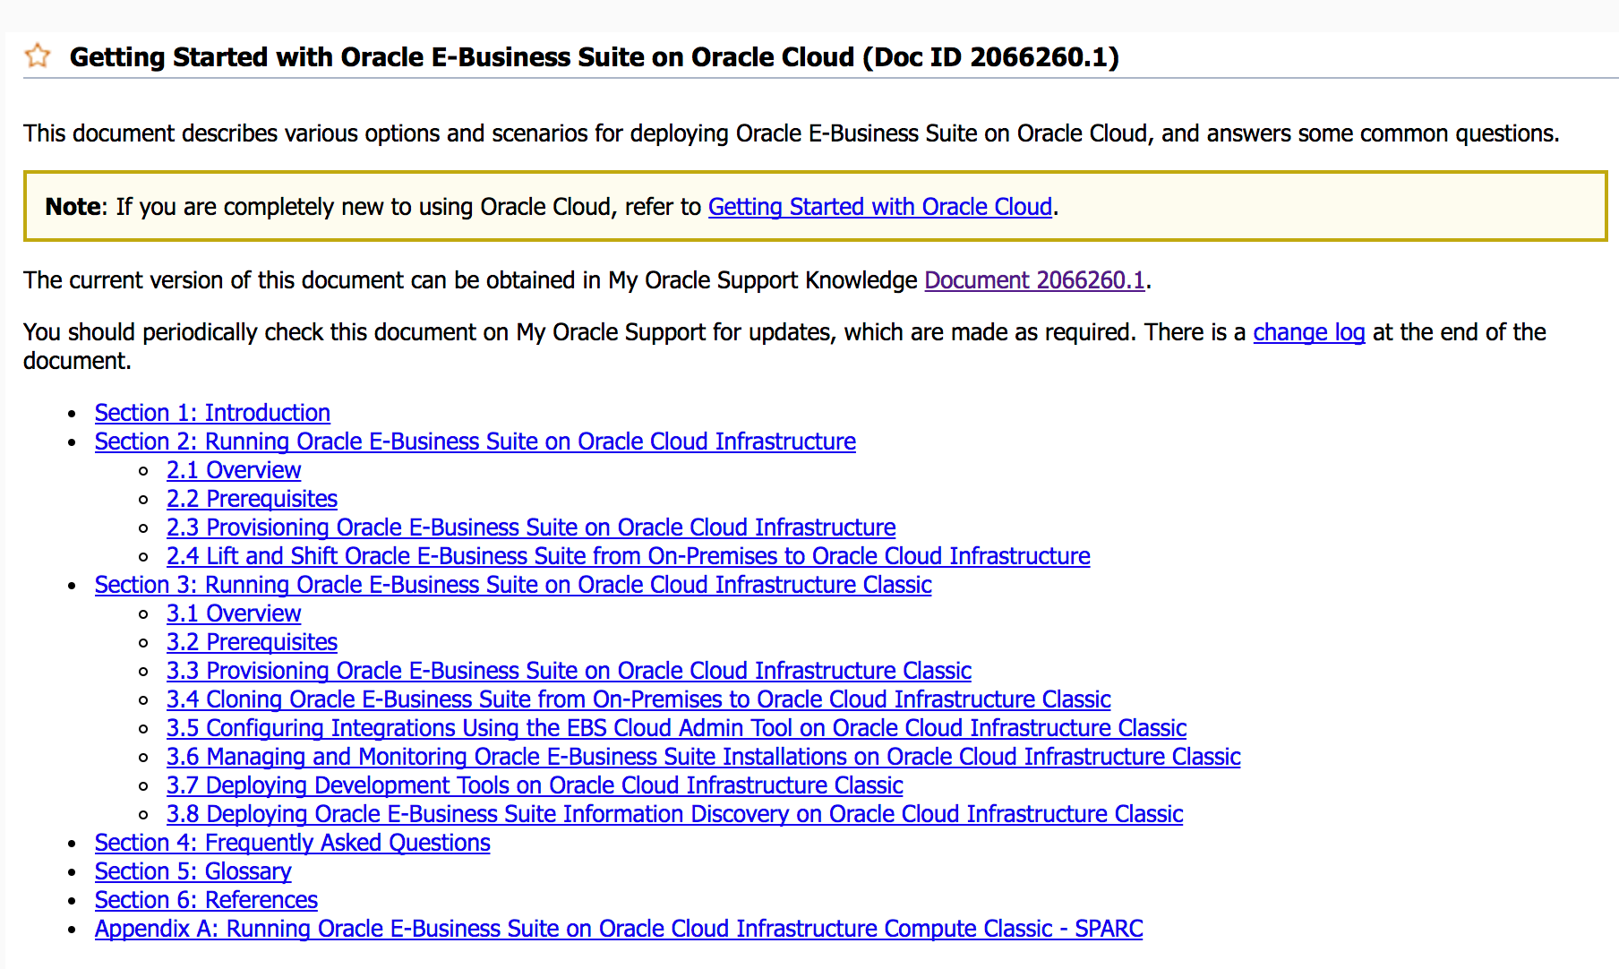
MOS Note: Getting Started with Oracle E-Business Suite on Oracle Cloud (Doc ID 2066260.1)

Slide 20
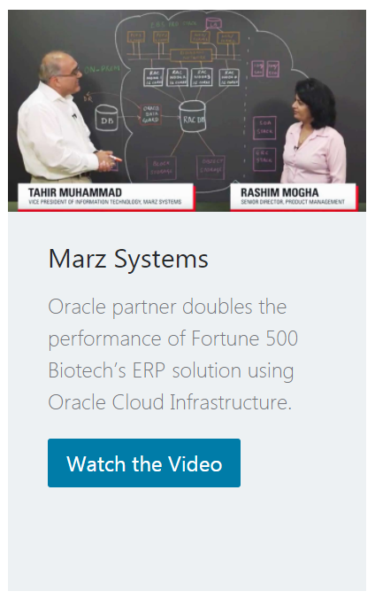
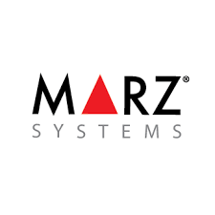


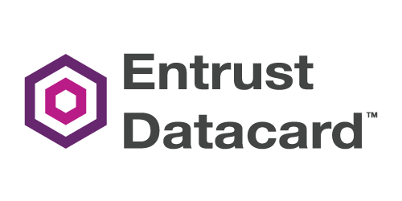
More Customer Success Stories

